Slide 1
Wars In Israel Since May 14, 1948
The War of Independence (1947-1949)
Sinai War (1956)
Six-Day War (1967)
War of Attrition (1967-1970)
Yom Kippur War (1973)
Operation Litani (1978)
First Lebanon War (1982-1985)
Security Zone Campaign (1985-2000)
First Intifada (1987-1993)
Second Intifada(2000-2005)
Second Lebanon War (2006)
Operation Cast Lead (2008-2009)
Operation Pillar of Defense (2012)
Operation Protective Edge (2014)
2021 Israel-Palestine Crisis (2021)
Israel-Hamas War (2023)

Slide 2
Did The Jews Receive All The Land?
Most Of The Bible’s Geography Focuses In This Area.
Genesis 12:1-3, 6-9
Genesis 13:3-4, 12, 14-18
Genesis 15:13-21
Exodus 3:16-17, 13:10-11
Deuteronomy 1:3-8, 9:4-5
Joshua 1:2-5
Joshua 21:43-45, 23:14
I Kings 4:1, 20-21, 24-25
Nehemiah 9:8

Slide 3
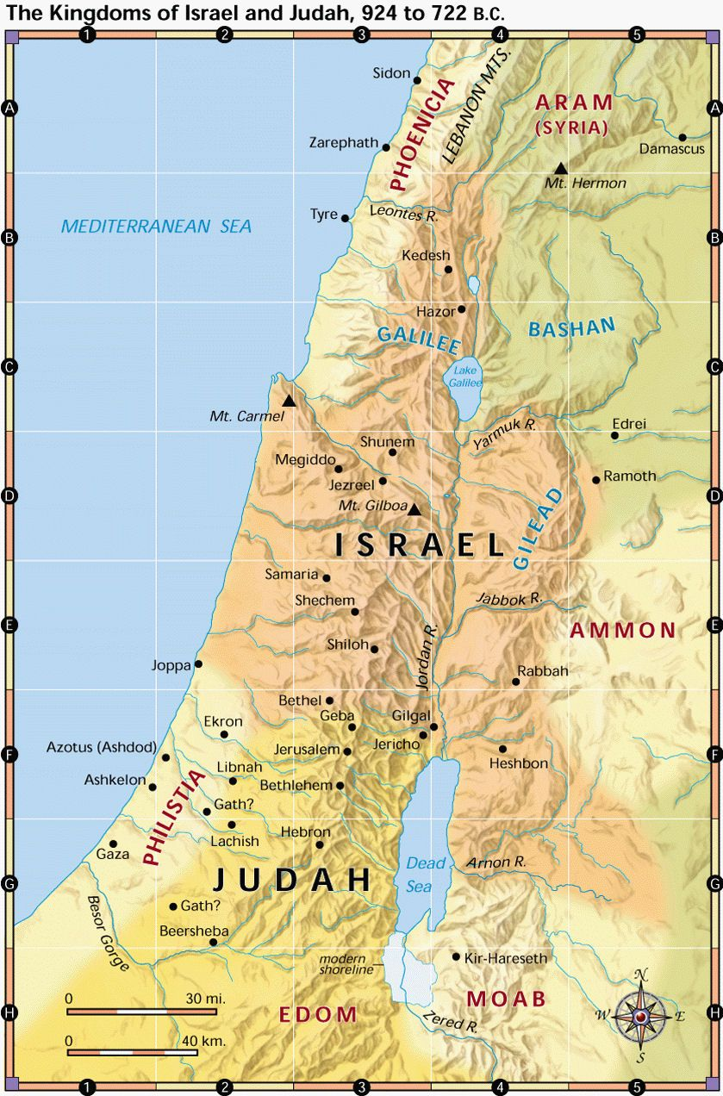
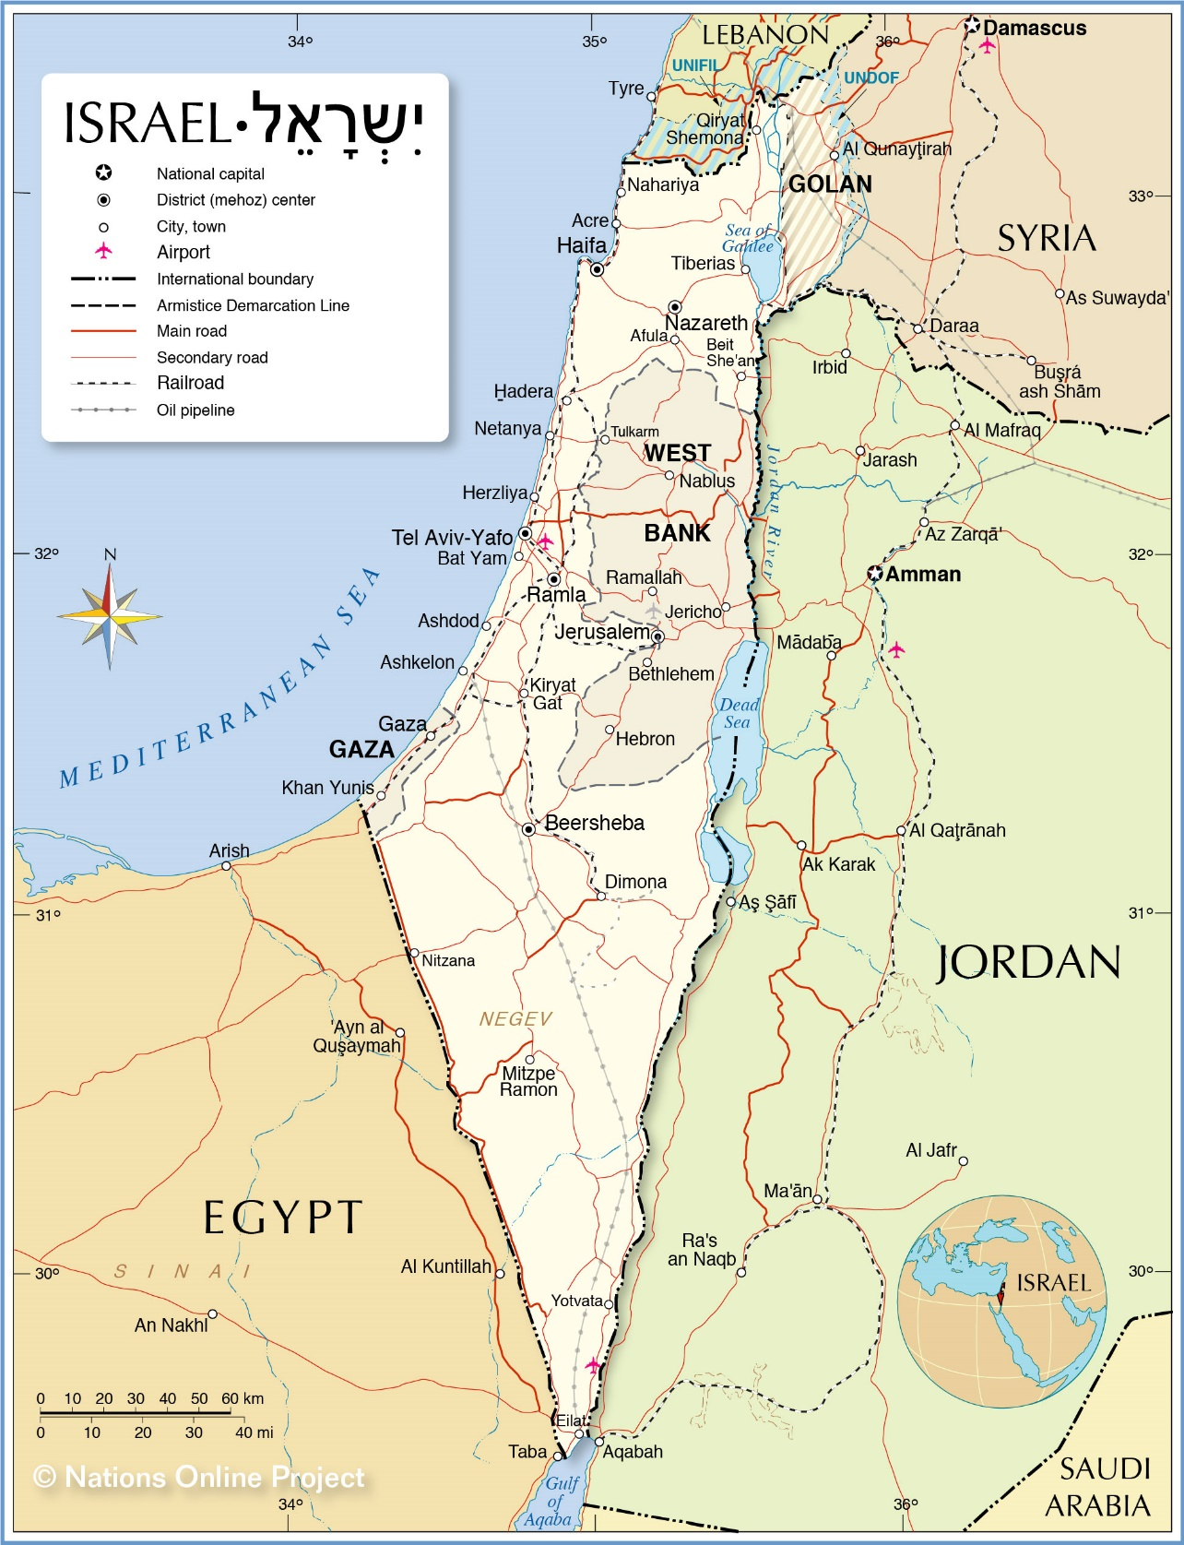
Did The Jews Receive All The Land?
Israel in Old Testament Days
Israel Today

Slide 4
Did The Jews Receive All The Land?
Did The Jews Have All The Land Or Not?
The passages we studied earlier declare they got all of the land!
These were not unconditional but conditional promises based on their obedience!
Deuteronomy 28:7, 15, 25
Joshua 23:8-13, 15-16
Daniel 9:5-11

Slide 5
Did The Jews Receive All The Land?
Did The Jews Have All The Land Or Not?
They got the land, but Jesus promised an ultimate end to the nation of Israel.
John 4:20-23
Matthew 23:37-38 (contr.) John 2:16
Matthew 24:2, (the description until v. 36)
By 70 AD, the Israelite nation was no more!

Slide 6
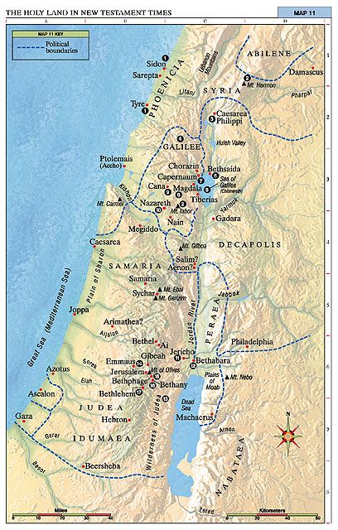
Did The Jews Receive All The Land?
Israel in New Testament Days
This nation began on May 14, 1948, by the U.N., recognized as a nation by the US, Soviets, Poland, Czechoslovakia, Guatemala, Uruguay, South Africa.
This nation was gone after 70 AD!

Slide 7
Did The Jews Receive All The Land?
What Does This Means For Us?
God is not focused on national boundaries but a spiritual nation (Dan. 2:44-45).
Israel was lost (Matt. 21:28-46)
Christ’s kingdom is not physical/earthly (Jn. 18:36)
Galatians 6:16
All Christians are considered the “circumcised” (Rom. 2:28-29).

Slide 8
“What Must I Do To Be Saved?”
Hear The Gospel (Rom. 10:17)
Believe In Christ (Jn. 8:24)
Repent Of Sins (Lk.13:3)
Confess Christ (Rom. 10:10)
Be Baptized (I Pet. 3:21)
For The Erring Child:
Repent (Acts 8:22), Confess (I Jn. 1:9), Pray (Acts 8:22)

