Slide 1
Chapter 4
“Where do wars and fights come from among you?” (v. 1)
“Draw near to God” (v. 8)
“Do not speak evil of one another, brethren.” (v. 11)

Slide 2
What is your life?
4:13-17
“Life is…”

Slide 3
Life is Uncertain
Come now, you who say, “Today or tomorrow we will go to such and such a city, spend a year there, buy and sell, and make a profit”; ¹⁴ whereas you do not know what will happen tomorrow.
Not condemning planning (Pro 6:6-8)
Planning without understanding…
Uncertainty of life (Pro 27:1)
Living without God (Luke 12:16-21)

Slide 4
Life is Brief
For what is your life? It is even a vapor that appears for a little time and then vanishes away.
Vanishes away (diminish, comes to end)
“All flesh is grass, and all its loveliness is like the flower of the field. ⁷ The grass withers, the flower fades, Because the breath of the LORD blows upon it; Surely the people are grass. ⁸ The grass withers, the flower fades, But the word of our God stands forever.” (Isa. 40)

Slide 5
…Dependent on God
¹⁵ Instead you ought to say, “If the Lord wills, we shall live and do this or that.”
Live by His mercy (Acts 17:28)
Only One capable of guiding us…
No one cares like Him (Isa. 46:3-5)
Eternal view (vv. 9-10)

Slide 6
Life is Accountability
¹⁷ Therefore, to him who knows to do good and does not do it, to him it is sin.
Sin of Omission (Lev. 6:12-13)
Everyone answers to God (Rom 14:10-12)
“For we shall all stand before the judgment seat of Christ. For it is written: ‘As I live, says the Lord, every knee shall bow to Me, and every tongue shall confess to God.’ So then each of us shall give account of himself to God.”

Slide 7
What is your life?
Uncertain
Brief
Dependent on God
Accountability
Jas. 4
“Life is…”

Slide 8
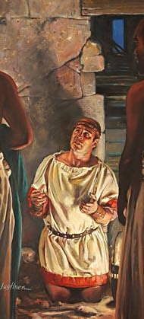
Acts 16
²⁹ Then he called for a light, ran in, and fell down trembling before Paul and Silas. ³⁰ And he brought them out and said, “Sirs, what must I do to be saved?”
³³ And he took them the same hour of the night and washed their stripes. And immediately he and all his family were baptized.

