Slide 1
The Healing Of Aeneas
Acts 9 – By this time in history …
Great success in preaching (Acts 2-4)
Persecution began (Acts 5-7)
Christians were scattered (Acts 8)
Saul/Paul converted (Acts 9)
Text: Acts 9:32-35

Slide 2
The Healing Of Aeneas
The Setting
“All quarters…” where? (Acts 9:31)
Then, to Lydda…

Slide 3
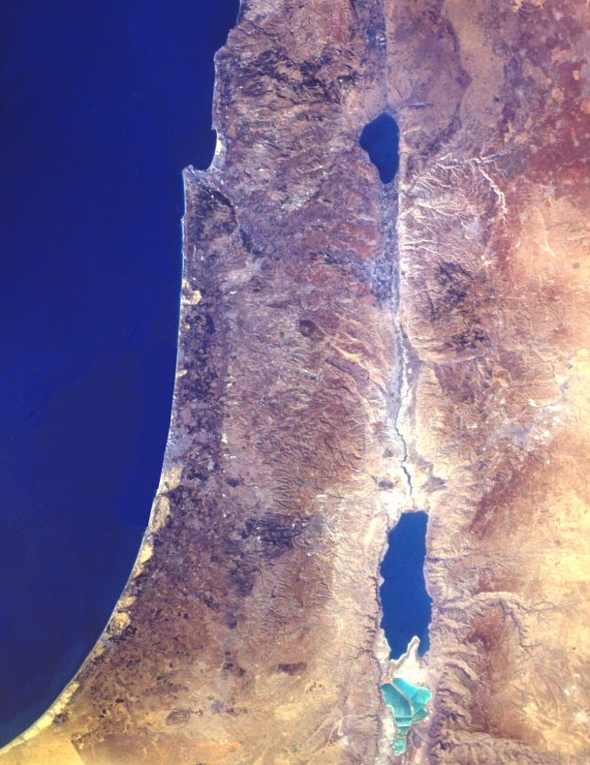
Israel in the New Testament
Sidon
Caesarea
Philippi
Tyre
Capernaum
Bethsaida
Nazareth
Sea of Galilee
Israel in the New Testament
Caesarea
Mediterranean
Jordan River
Joppa
Lydda
Jerusalem
Dead Sea
Gaza
Notes:
Review the N.T. map of Israel. Note that the land is no longer divided by tribes. The people, however kept detailed records of their lineage and could easily describe from what tribe they had descended. This was particularly important in regards to determining who could serve as priest. Only descendants of the tribe of Levi were allowed to serve as priests.

Slide 4
The Healing Of Aeneas
The Setting
A church was in Lydda (Acts 9:32)
Origin? - No specific Biblical evidence
Some things we know:
Heard/Obeyed same message as Acts 2, Acts 4, 5-6, 8-9!
They engaged in the same worship (Acts 2:42; Jn. 4:24)

Slide 5
The Healing Of Aeneas
A Lame Man Healed
Aeneas had been paralyzed for 8 years (Acts 9:33)!
In being healed, he was a recipient of God’s blessings, and a tool in converting others (Acts 9:35)!
Jn. 9:2-3; Matt. 9:24-26; Jn. 11:43, 47-48
Purpose of miracles: (Ex. 4:1-5, 8, 30-31; Jn. 2:11, 23, 4:53)

Slide 6
The Healing Of Aeneas
Peter, God’s Agent
In Healing
Acts 9:32-35 → Mark 16:19-20
Acts 3:6-8
Acts 9:34 - “Jesus Christ maketh thee whole”
Peter stands out as a great example of humility, faith, and trust in God!

Slide 7
The Healing Of Aeneas
Peter, God’s Agent
In Teaching
Acts 9:35 - How can they turn to the Lord without hearing God’s word?
Might Peter have told these folks….
Hear? (Acts 2:22)
Believe? (Acts 2:36)
Repent & Be Baptized? (Acts 2:38)
YES!!!! (Gal. 1:8)

Slide 8
The Healing Of Aeneas
Applications To Us
1) This account emphasizes God’s power over physical and spiritual illness.
2) Do YOU believe these things?
Some don’t!
Believing the miracles demands believing the WORDS which record the miracles.

Slide 9
The Healing Of Aeneas
Applications To Us
Do YOU believe these things?
Believe it all!
Believe it is all true!
Believe it is relevant!
Believe the rest of the Bible!
Obey it!
Proclaim it!
Jn. 11:47-48
I Tim. 4:16; II Tim. 2:2
Rom. 1:16

Slide 10
“What Must I Do To Be Saved?”
Hear The Gospel (Rom. 10:17)
Believe In Christ (Jn. 8:24)
Repent Of Sins (Lk.13:3)
Confess Christ (Rom. 10:10)
Be Baptized (I Pet. 3:21)
For The Erring Child:
Repent (Acts 8:22), Confess (I Jn. 1:9),
Pray (Acts 8:22)

