Slide 1
God Versus Idols
Jeremiah 10:5; I Corinthians 12:2
Psalm 115:4-8
Habakkuk 2:18-19
Isaiah 44:9-17

Slide 2
God Versus Idols
A Brief History Of Idolatry Among God’s People
Terah (Josh. 24:2); Rachel (Gen. 31:19)
Jacob (Gen. 35:4); Israelites (Ex. 20:3-5, ch. 32, 34:13-14); Judges (Judges 2:11-19)
Kings (I Kng. 12:31-32, 14:22-23, 15:14, 22:43; II Kng. 12:3, 14:4, 15:4, 15:35)
Jews (Jer. 7:8-11, 10:1-6)

Slide 3
God Versus Idols
A Brief History Of Idolatry Among God’s People
Christians!! (I Cor. 8:4, 10:6-7, 14, 19-20; II Cor. 6:14-17; Col. 3:5; I Jn. 5:21; Rev. 2:14, 20)

Slide 4
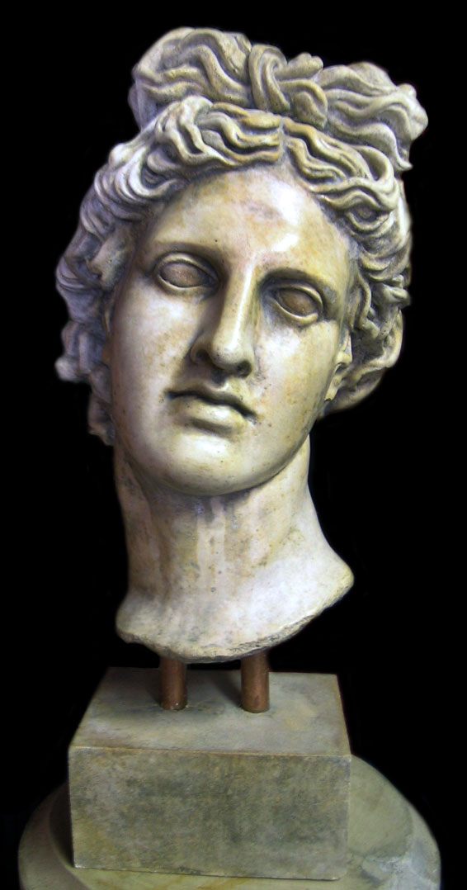
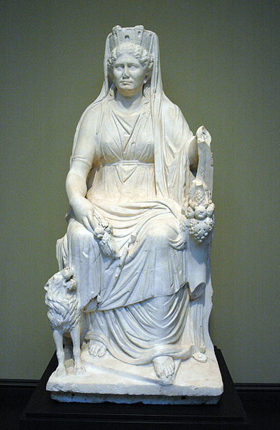
God Versus Idols
Explanation Of Idols
Some Small (Gen. 31:19, 34; Acts 19:24)

Slide 5
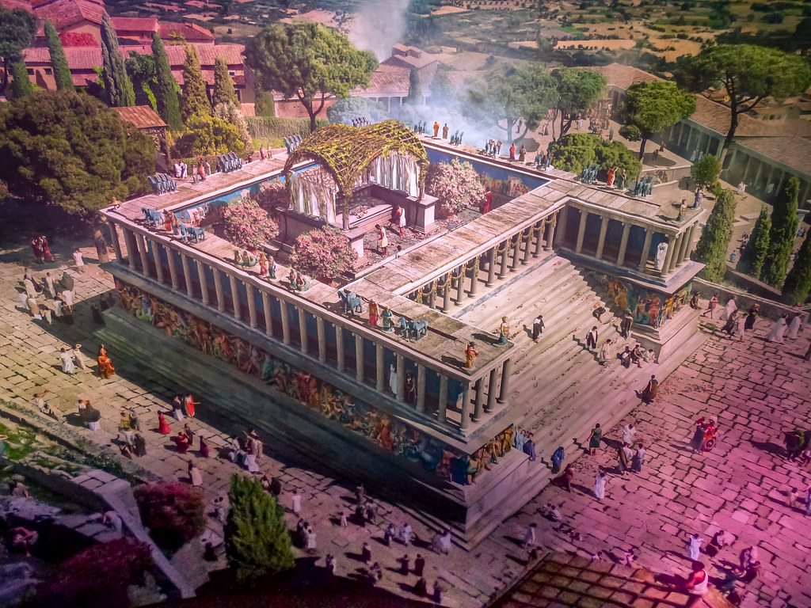
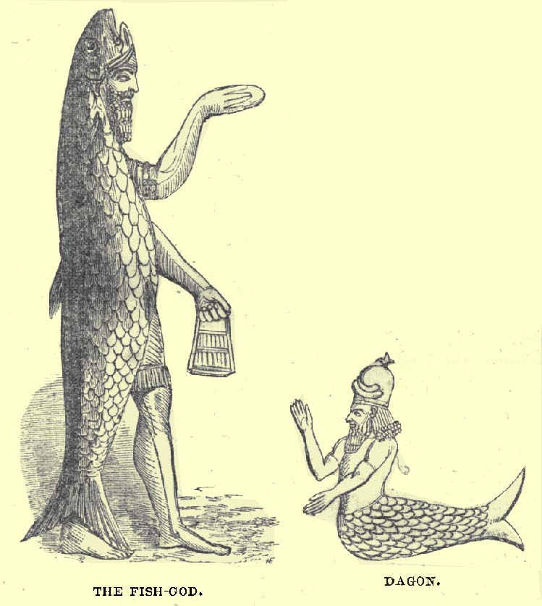
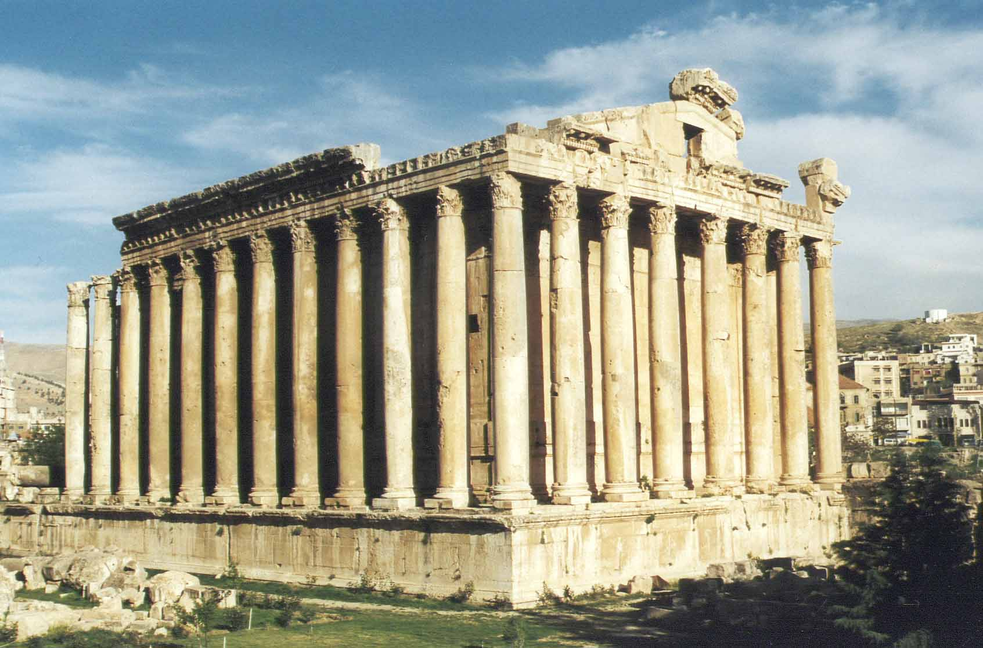
God Versus Idols
Explanation Of Idols
Some Large (I Sam. 5:1-4; Acts 19:27)

Slide 6
God Versus Idols
Explanation Of Idols
Some Small (Gen. 31:19, 34; Acts 19:24)
Some Large (I Sam. 5:1-4; Acts 19:27)
Some were/are unseen (Col. 3:5)
God’s consistent answer to idolatry is:
PUT IT AWAY AND STAY AWAY!!
Ex. 20:3-5; Deut. 13:1-5, 6-11, 12-18
I Cor. 10:14, I Jn. 5:21

Slide 7
God Versus Idols
What Is Your Idol?
Mom/Dad? Son/Daughter? Husband/Wife?
(Mk. 10:37; Lk. 14:26; Matt. 22:37)
Personal Possessions? (Col. 3:5)
My own thoughts/experiences? (Prov. 14:12)
Friends? (I Cor. 15:33)
Drugs, Alcohol, Tobacco/Vaping? (I Cor. 6:19-20, 6:12; Matt. 5:13-16)

Slide 8
God Versus Idols
What Is Your Idol?
Mom/Dad? Son/Daughter? Husband/Wife?
(Mk. 10:37; Lk. 14:26; Matt. 22:37)
Personal Possessions? (Col. 3:5)
My own thoughts/experiences? (Prov. 14:12)
Friends? (I Cor. 15:33)
Drugs, Alcohol, Tobacco? (I Cor. 6:19-20, 6:12; Matt. 5:13-16)
What Idol Are You Worshipping??

Slide 9
“What Must I Do To Be Saved?”
Hear The Gospel (Rom. 10:17)
Believe In Christ (Jn. 8:24)
Repent Of Sins (Lk.13:3)
Confess Christ (Rom. 10:10)
Be Baptized (I Pet. 3:21)
For The Erring Child:
Repent (Acts 8:22), Confess (I Jn. 1:9),
Pray (Acts 8:22)

