Slide 1
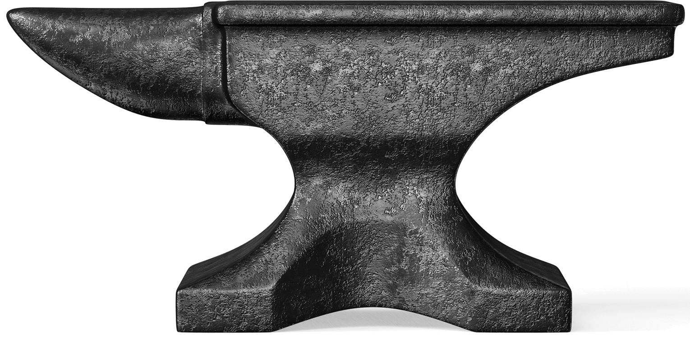
The Treasure Of The Bible
“Last eve I paused beside a blacksmith’s door
And heard the anvil ring the vesper chime,
Then looking in, I saw upon the floor
Old hammers worn with beating years of time.
‘How many anvils have you had,’ said I,
‘To wear and batter all these hammers so?’
“Just one,’ he said; then with twinkling eye,
‘The anvil wears the hammers out you know.’
And so, I thought, the anvil of God’s word
For ages skeptics blows have beaten upon,
Yet though the noise of falling blows was heard,
The anvil is unharmed — the hammers gone!”

Slide 2
The Treasure Of The Bible
Though there have been many critics through the years, the Bible remains!
Eben Ezra (12th Century)
Carlstadt (Contem. with Martin Luther)
Hobbs (17th Century)
Voltaire (18th Century)
Ferdinand Christian Baur (19th Century)

Slide 3
The Treasure Of The Bible
This is not a man-made book, but a book written by divine inspiration!
Matthew 24:35; Psalm 119:89
I Peter 1:23, 25
II Timothy 3:16-17 – “inspiration” = “divinely breathed-in” (Strong’s)

Slide 4
The Treasure Of The Bible
EXTERNAL EVIDENCE
The Bible has more manuscript evidence than any other piece of literature.
The Bible has more manuscript evidence than any other 10 pieces of classical literature.
24,000 manuscript copies/portions of the New Testament in existence today!

Slide 5
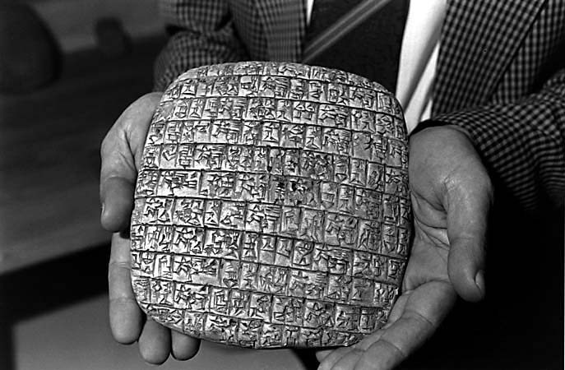
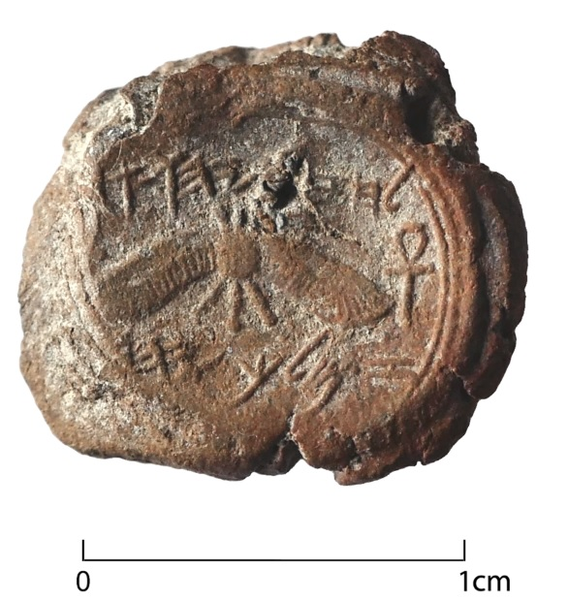
The Treasure Of The Bible
EXTERNAL EVIDENCE
“Belonging to Hezekiah, son of Ahaz, king of Judah

Slide 6
The Treasure Of The Bible
EXTERNAL EVIDENCE
The “Dead Sea Scrolls” (1947)
Abdi-Heba’s letter to Pharaoh Akhanaton (see: Josh. 10:1-5, 26-28)
Balaam (Num. 24:3-4)
Hittites (Gen.-Neh.)
Erastus (Acts 19:22; Rom. 16:23; II Tim. 4:20)

Slide 7
The Treasure Of The Bible
EXTERNAL EVIDENCE
Pontius Pilate (Matt., Mk. Lk. Jn.)
Moses’ Seat (Matt. 23:2)
Scientific Accuracy:
“In the beginning (time) God (force) created (motion/action) the heaven (space) and the earth (matter).” (Gen. 1:1)

Slide 8
The Treasure Of The Bible
EXTERNAL EVIDENCE
Scientific Accuracy
Life in blood (Lev.17)
Quarantines (Lev. 13)
Sanitation (Num. 19)
Job 26:7
Stars (Gen.15:5)
Popular Thinking
Leeches, “Bleeding”
No isolation of sick
Not appreciated
Elephant, Atlas, etc.
Stars all counted!

Slide 9
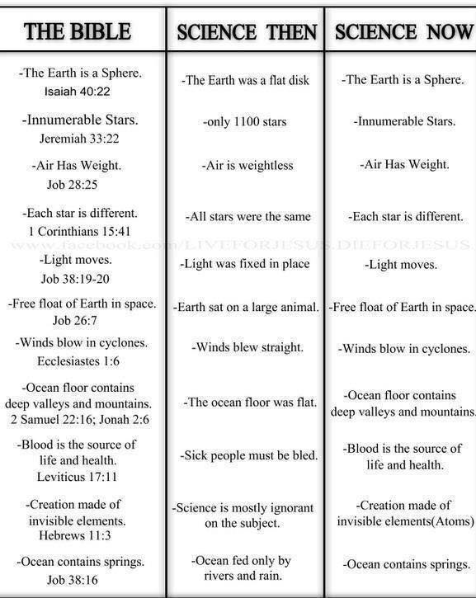
The Treasure Of The Bible
EXTERNAL EVIDENCE

Slide 10
The Treasure Of The Bible
EXTERNAL EVIDENCE
Geographic Accuracy:
“Up” to Jerusalem and “Down” to Jericho! (Gal. 1:17-18; Jn. 5:1; Josh. 16:7; Lk. 10:30)
Cell Structure:
I Corinthians 15:39 – “one flesh of …”

Slide 11
The Treasure Of The Bible
INTERNAL EVIDENCE
The statements, prophecies in the Bible show it to be true and without contradiction!
332 prophecies fulfilled in Christ!
(Ex: Isa. 53; Zech. 11:12-13; Gen. 3:15)

Slide 12
The Treasure Of The Bible
INTERNAL EVIDENCE
The Continuity Of The Scriptures
What would you do in an attempt to write a book where several authors contributed a chapter?
THE BIBLE was written over 1600 years by about 40 writers from every walk of life!

Slide 13
The Treasure Of The Bible
INTERNAL EVIDENCE
THE BIBLE was written over 1600 years by about 40 writers from every walk of life!
Authors
Locations
Wilderness
Dungeon
Palace
Prison
Languages
Hebrew
Aramaic
Greek
Moses
Peter
Amos
Joshua

Slide 14
The Treasure Of The Bible
INTERNAL EVIDENCE
“Circular Reasoning!”
Not so!
Listening to 40 different witnesses over 1500 years and finding unity of testimony in the record is simply evaluating the strength of testimony. That is not circular reasoning at all!

Slide 15
The Treasure Of The Bible
INTERNAL EVIDENCE
The New Testament Bears Witness To The Old Testament.
Further Evidence:
God’s Plan For The Home (Gen. 2:18)
Prophecies Fulfilled (I Kings 13; Isa. 45)
Military Campaigns

Slide 16
The Treasure Of The Bible
“Last eve I paused beside a blacksmith’s door
And heard the anvil ring the vesper chime,
Then looking in, I saw upon the floor
Old hammers worn with beating years of time.
‘How many anvils have you had,’ said I,
‘To wear and batter all these hammers so?’
“Just one,’ he said; then with twinkling eye,
‘The anvil wears the hammers out you know.’
And so, I thought, the anvil of God’s word
For ages skeptics blows have beaten upon,
Yet though the noise of falling blows was heard,
The anvil is unharmed — the hammers gone!”

Slide 17
“What Must I Do To Be Saved?”
Hear The Gospel (Rom. 10:17)
Believe In Christ (Jn. 8:24)
Repent Of Sins (Lk.13:3)
Confess Christ (Rom. 10:10)
Be Baptized (I Pet. 3:21)
For The Erring Child: Repent (Acts 8:22), Confess (I Jn. 1:9),
Pray (Acts 8:22)

