Slide 1
God’s Providence Is Seen In The Lives Of Folks…
Joseph (Gen. 37-45)
Young Maid (II Kings 5:1-14)
Daniel (Daniel 2:47, 6:26-27)
God’s Providence Is Seen In Other Ways, Too!
Jethro was a Priest (Ex. 2:16, 3:1, 18:1, 12)
Pharaoh/Abimelech (Gen. 12:14-20, 20:1-18)
“Heathen” nations (Rom. 4:15, 5:13)
China …

Slide 2
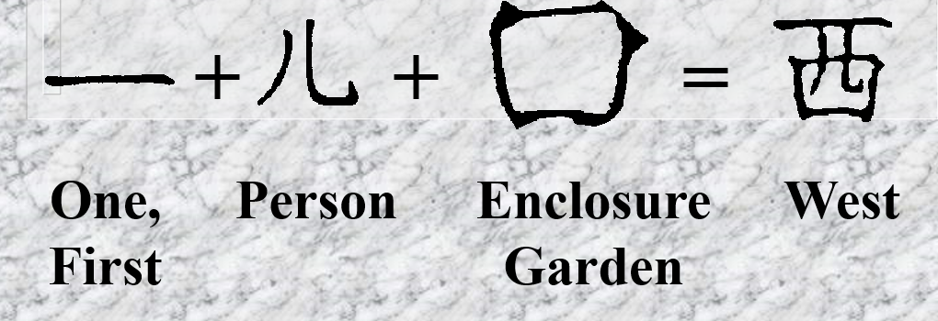
God’s Providence Is Seen In The Lives Of Folks…
Joseph (Gen. 37-45)
Young Maid (II Kings 5:1-14)
Daniel (Daniel 2:47, 6:26-27)
God’s Providence Is Seen In Other Ways, Too!
Jethro was a Priest (Ex. 2:16, 3:1, 18:1, 12)
Pharaoh/Abimelech (Gen. 12:14-20, 20:1-18)
“Heathen” nations (Rom. 4:15, 5:13)
China …

Slide 3
God’s Providence Is Seen In The Lives Of Folks…
Joseph (Gen. 37-45)
Young Maid (II Kings 5:1-14)
Daniel (Daniel 2:47, 6:26-27)
God’s Providence Is Seen In Other Ways, Too!
Jethro was a Priest (Ex. 2:16, 3:1, 18:1, 12)
Pharaoh/Abimelech (Gen. 12:14-20, 20:1-18)
“Heathen” nations (Rom. 4:15, 5:13)
China … European explorers … Early Americans

Slide 4
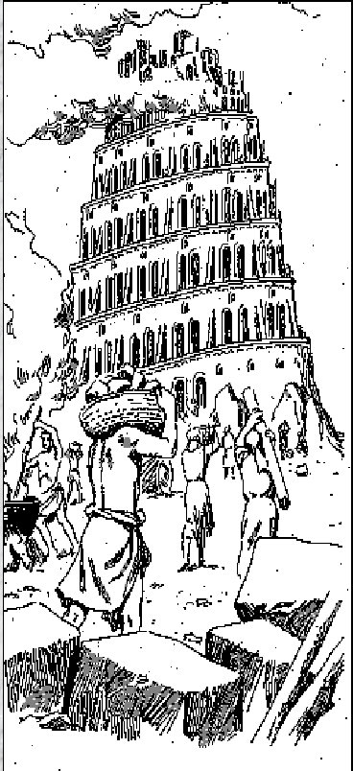
God’s Scattering
BABEL
Genesis 11
God’s intention (Gen. 1:28, 8:16-17, 9:1, 7)
These people would have had Noah to talk to (Gen. 9:28) as well as the 3 sons!
Due to their sin, God scattered the people! (v. 8-9)
We see the rise of nations and languages.

Slide 5
God’s Scattering
BABYLONIAN CAPTIVITY
II Kings 24-25
Nebuchadnezzar took these folks away in three campaigns.
Some good comes from the captivity:
Daniel and three friends (Dan. 1-6)
They had the chance to teach others.

Slide 6
God’s Scattering
THE CHRISTIANS IN ACTS 8
The Christians were forced out of Jerusalem.
Philip: Samaria; Eunuch; on to Caesarea.
Acts 11:19-26, 28:14-15
Philippians 1:12-13
James 1:1; I Peter 1:1
Is there any wonder we read of Christians in India, China, etc.?
Colossians 1:5-6, 23

Slide 7
God’s Scattering
APPLICATIONS FOR US
This is God’s way to spread His word…
The first 2 “scatterings” were due to sin.
Last was due to men’s sinful actions!
What about US!?!
“The World’s Bible”
II Timothy 2:2
If we are not scattering to teach (Acts 8), God will scatter us (Gen. 11; II Kings 24-25)!

Slide 8
“What Must I Do To Be Saved?”
Hear The Gospel (Rom. 10:17)
Believe In Christ (Jn. 8:24)
Repent Of Sins (Lk.13:3)
Confess Christ (Rom. 10:10)
Be Baptized (I Pet. 3:21)
For The Erring Child:
Repent (Acts 8:22), Confess (I Jn. 1:9),
Pray (Acts 8:22)

